Slide 1
Data Models

Slide 2
E-R Diagram
Entity relationship model defines the conceptual view of database.
It works around real world entity and association among them.

Slide 3
Entity
A real-world thing either animate or inanimate that can be easily identifiable and distinguishable.
For example, in a school database, student, teachers, class and course offered can be considered as entities
An entity set is a collection of similar types of entities. Entity set may contain entities with attribute sharing similar values.

Slide 4
Attributes
Entities are represented by means of their properties, called attributes.
For example, a student entity may have name, class, age as attributes.

Slide 5
Types of attributes:
Simple attribute:
Simple attributes are atomic values, which cannot be divided further.
For example, student's phone-number is an atomic value of 10 digits.
Composite attribute:
Composite attributes are made of more than one simple attribute.
For example, a student's complete name may have first_name and last_name.
Derived attribute:
Derived attributes are attributes, which do not exist physical in the database, but there values are derived from other attributes presented in the database.
For example, average_salary in a department should be saved in database instead it can be derived.
For another example, age can be derived from data_of_birth.

Slide 6
Single-valued attribute:
Single valued attributes contain on single value.
For example: Social_Security_Number.
Multi-value attribute:
Multi-value attribute may contain more than one values.
For example, a person can have more than one phone numbers, email_addresses etc.

Slide 7
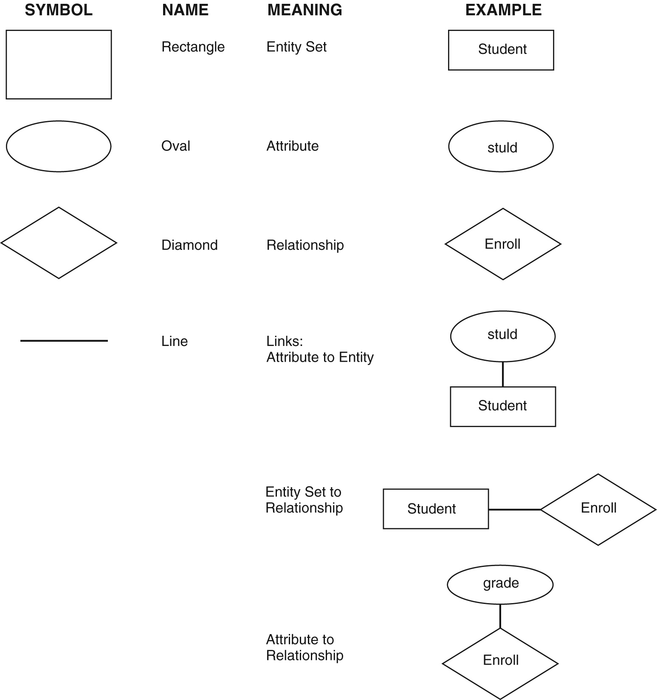
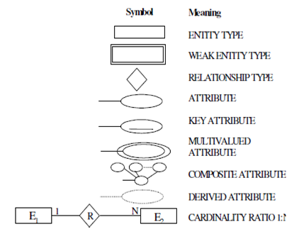

Slide 8
Relationship
The association among entities is called relationship.
For example, employee entity has relation works_at with department
Relationship Set:
Relationship of similar type is called relationship set.
Degree of relationship
The number of participating entities in an relationship defines the degree of the relationship.
Binary = degree 2
Ternary = degree 3
n-ary = degree

Slide 9
Mapping Cardinalities:
Cardinality defines the number of entities in one entity set which can be associated to the number of entities of other set via relationship set.

Slide 10
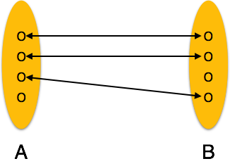
One-to-one: one entity from entity set A can be associated with at most one entity of entity set B and vice versa

Slide 11
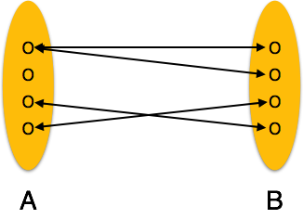
One-to-many: One entity from entity set A can be associated with more than one entities of entity set B but from entity set B one entity can be associated with at most one entity.

Slide 12
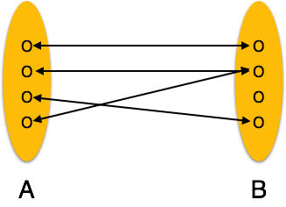
Many-to-one: More than one entities from entity set A can be associated with at most one entity of entity set B but one entity from entity set B can be associated with more than one entity from entity set A.

Slide 13
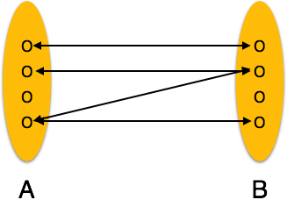
Many-to-many: one entity from A can be associated with more than one entity from B and vice versa.

Slide 14
ER Diagram Representation
Entity
Entities are represented by means of rectangles. Rectangles are named with the entity set they represent.

Slide 15
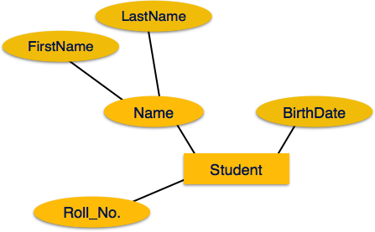
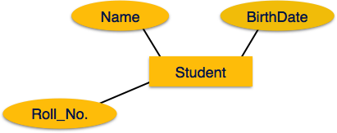
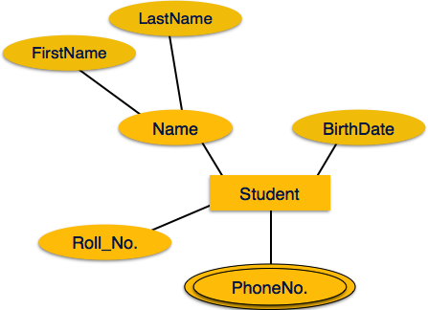
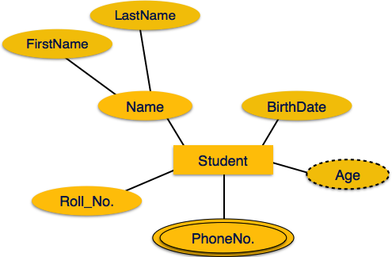
Attributes

Slide 16
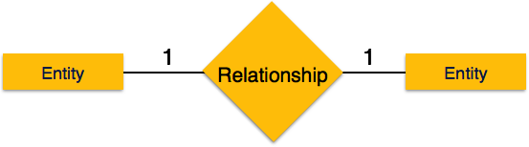
relationship and cardinality
One-to-one
When only one instance of entity is associated with the relationship, it is marked as '1'. This image below reflects that only 1 instance of each entity should be associated with the relationship. It depicts one-to-one relationship.

Slide 17

One-to-many
When more than one instance of entity is associated with the relationship, it is marked as 'N'. This image below reflects that only 1 instance of entity on the left and more than one instance of entity on the right can be associated with the relationship. It depicts one-to-many relationship.

Slide 18

Many-to-one
When more than one instance of entity is associated with the relationship, it is marked as 'N'. This image below reflects that more than one instance of entity on the left and only one instance of entity on the right can be associated with the relationship. It depicts many-to-one relationship

Slide 19

Many-to-many
This image below reflects that more than one instance of entity on the left and more than one instance of entity on the right can be associated with the relationship. It depicts many-to-many relationship.

Slide 20
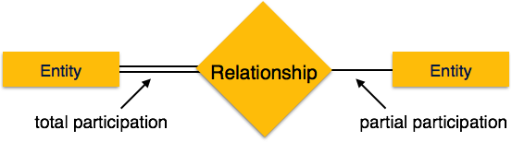
Participation Constraints
Total Participation: Each entity in the entity is involved in the relationship. Total participation is represented by double lines.
Partial participation: Not all entities are involved in the relation ship. Partial participation is represented by single line.

Slide 21
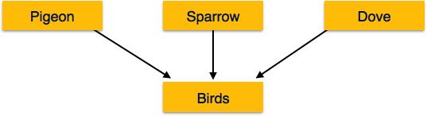
Generalization Aggregation
In generalization, a number of entities are brought together into one generalized entity based on their similar characteristics. For an example, pigeon, house sparrow, crow and dove all can be generalized as Birds

Slide 22
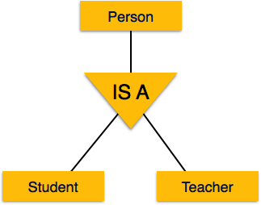
Specialization
Specialization is a process, which is opposite to generalization, as mentioned above. In specialization, a group of entities is divided into sub-groups based on their characteristics.
In a company, a person can be identified as employee, employer, customer or vendor based on what role do they play in company.

Slide 23
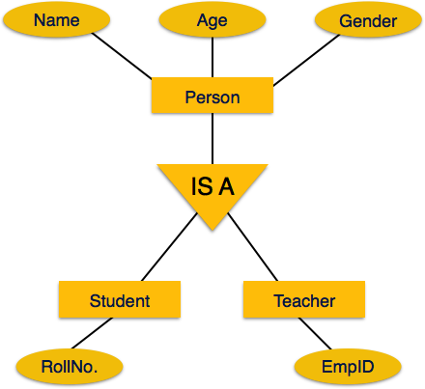
Inheritance
The important features of Generalization and Specialization, is inheritance, that is, the attributes of higher-level entities are inherited by the lower level entities.

Slide 24
Hierarchical Model
First hierarchical data model was designed by IBM and North American Rockwell in 1950.
Records are arranged in tree like structure, and are linked with their superior records on which they are dependent and to them which are dependent on them.
One to many relationship.

Slide 25
Operations on Hierarchical Model
Insert
Update
Delete
Retrieval of information

Slide 26
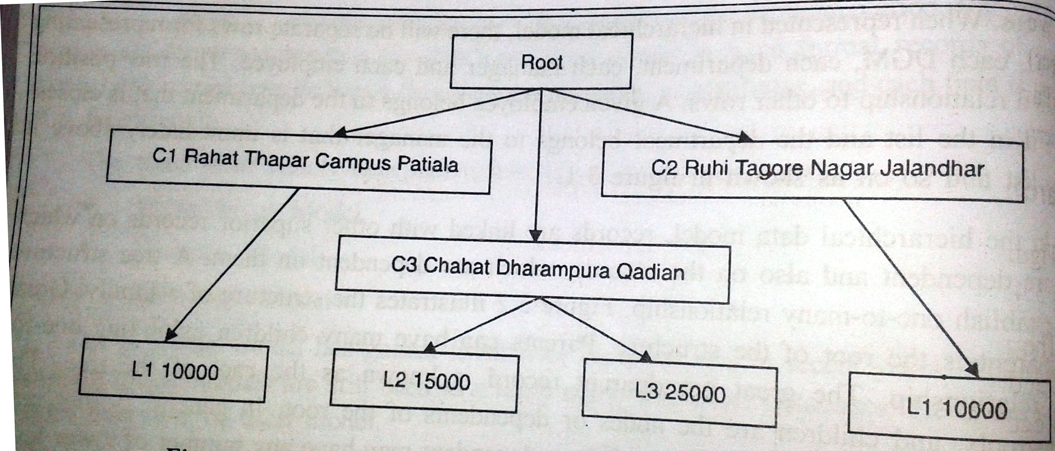

Slide 27
Advantages/ Disadvantages
Advantages:
Simplicity
Data security
Data integrity
Efficiency
Disadvantages
Implementation complexity
Database management problem
Lack of structural independence

Slide 28
Network Model
Network model replace the tree structure with graph.
Advantages:
Conceptual simplicity
Capable to handle more relationship typed: 1:N,N:N
Data integrity
Data independence
Database standards:
ANSI in 1970
Disadvantages :
System complexity
Operational anomalies
Absence of structural independence

Slide 29
